Slide 1
Irritable bowel syndrome(IBS)

Slide 2
Objectives:
At the end of this lecture, the student must be able to :
Know what is IBS ?
What is Rome criteria ?
How can differentiate IBS from other GI syndromes ?
How can approach to a patient suspected to have IBS ?

Slide 3
INTRODUCTION
characterised by recurrent abdominal pain in association with abnormal defecation in the absence of a structural abnormality of the gut.
About 10–15% of the population are affected at some time but only 10% of these consult their doctors because of symptoms.
the most common cause of gastrointestinal referral and accounts for frequent absenteeism from work and impaired quality of life.
Young women are affected 2–3 times more often than men.
Coexisting conditions, such as non-ulcer dyspepsia, chronic fatigue syndrome, dysmenorrhoea and fibromyalgia, are common.
sometimes associated with a history of physical or sexual abuse

Slide 4
Pathophysiology
Incompletely understood
Different factors play a role in the pathophysiology :
Behavioural and psychosocial factors:
Acute psychological stress and overt psychiatric disease are known to alter visceral perception and gastrointestinal motility.
About 50% of patients referred to hospital have a psychiatric illness, such as anxiety, depression, somatisation and neurosis.
Panic attacks are also common.
Increased prevalence of abnormal illness behaviour, with frequent consultations for minor symptoms and reduced coping ability

Slide 5
2.Physiological factors:
IBS may be a serotoninergic (5-HT) disorder, as evidenced by relatively excessive release of 5-HT in diarrhoea-predominant IBS (D-IBS) and relative defciency with constipation-predominant IBS (C-IBS).
5-HT3 receptor antagonists are effective in D-IBS, while 5-HT4 agonists improve bowel function in C-IBS.
IBS may represent a state of low-grade gut inﬂammation or immune activation, not detectable by tests, with raised numbers of mucosal mast cells that sensitise enteric neurons by releasing histamine and tryptase.
Immune activation may be associated with altered CNS processing of visceral pain signals.
This is more common in women and in D-IBS, and may be triggered by a prior episode of gastroenteritis with Salmonella or Campylobacter species.

Slide 6
3. Luminal factors
Both quantitative and qualitative alterations in intestinal bacterial microbiota (gut dysbiosis )have been reported, this is supported by the development of symptoms in patients with SIBO and the response to nonabsorpable antibiotic( Refaximin).
Dietary factors are also important. Some patients have chemical food intolerances (not allergy) to poorly absorbed, short-chain carbohydrates (lactose, fructose and sorbitol, among others), collectively known as FODMAPs (fermentable oligo-, di- and monosaccharides, and polyols.
Non-coeliac gluten sensitivity (negative coeliac serology and normal duodenal biopsies) seems to be present in some IBS patients.
intolerant of chemicals such as salicylates or benzoates, found in certain foods.

Slide 7
Clinical features
The cardinal feature of IBS is the recurrent abdominal discomfort, that is :
Colicky or cramping in nature.
Felt in the lower abdomen.
Relieved by defecation.
Abdominal bloating worsens throughout the day; the cause is unknown but it is not due to excessive intestinal gas.
Altered bowel habits :
Mostly have alternate between episodes of diarrhoea and constipation(mixed type).
Some have diarrhea predominant
Some have constipation predominant

Slide 8
Constipation predominant type IBS:
Tend to pass infrequent pellety stools
in association with abdominal pain or proctalgia
Diarrhea predominant IBS:
frequent defecation but produce low-volume stools
Absent to rarely occurrence of nocturnal symptoms
Passage of mucus is common but rectal bleeding does not occur
In IBS :
NO Wt. loss
NO Nocturnal symptoms
NO Rectal bleeding
No fever
constitutionally well patient
Physical examination is generally unremarkable, with the exception of variable tenderness to palpation

Slide 9
Diagnostic criteria for IBS
Rome III criteria for diagnosis of irritable bowel syndrome:
Recurrent abdominal pain or discomfort on at least 3 days per month in the last 3 months, associated with two or more of the following:
• Improvement with defecation
• Onset associated with a change in frequency of stool
• Onset associated with a change in form (appearance) of stool .
Supporting diagnostic features for IBS:
• Presence of symptoms for more than 6 months
• Frequent consultations for non-gastrointestinal problems
• Previous medically unexplained symptoms
• Worsening of symptoms by stress.

Slide 10
Alarm features for IBS
• Age > 50 years; male gender
• Weight loss
• Nocturnal symptoms
• Family history of colon cancer
• Anaemia
• Rectal bleeding

Slide 11
Investigations:
The diagnosis of IBS is clinical and can be make with confident by the application of the Rome criteria combined with the absent of alarm of symptoms.
Investigations need to be done in atypical presentations in order to exclude other gastrointestinal diseases, like CBC with ESR, CRP, Stool for calprotectin with or without sigmoidoscopy , all of these investigations are normal in IBS.
Colonoscopy should be undertaken in older patients (over 40 years of age) to exclude colorectal cancer.
Diarrhoea-predominant patients justify investigations to exclude
coeliac disease
microscopic colitis
lactose intolerance
bile acid diarrhoea
thyrotoxicosis and, in developing countries, parasitic infection

Slide 12
RISK FACTORS for IBS
The best-accepted risk factor for IBS is bacterial gastroenteritis.
The risk of postinfection IBS has been reported to be increased with depression, adverse life events and hypochondriasis, female gender, younger age, and prolonged duration of diarrhea following the initial attack.
Bacterial virulence factors also may be important, but IBS also can follow non-bacterial enteritis, including viral gastroenteritis, and infection with Trichinella, or Giardia.
Other risk factors for IBS include:
an affluent childhood environment,
premenopausal and postmenopausal estrogen use,
recent antibiotic use,
food intolerance
extraintestinal somatic symptoms, and poor quality of life (QOL).
IBS runs in families, and low birth weight is also a risk factor for IBS, even after controlling for genetic influences.

Slide 13
Management

Slide 14
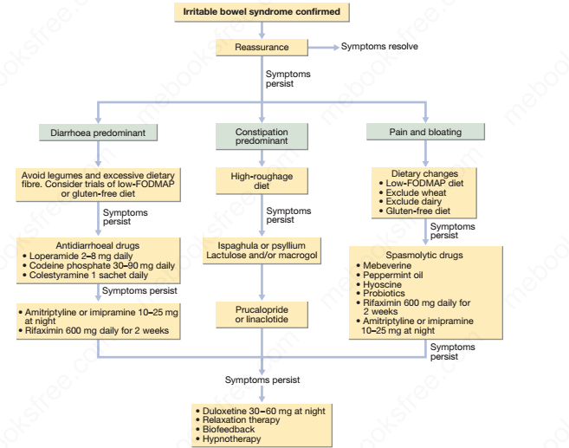

Slide 15
Management
The most important steps are to make a positive diagnosis and reassure the patient.
A cycle of anxiety leading to colonic symptoms,which further heighten anxiety, can be broken by explaining that symptoms are not due to a serious underlying disease but instead are the result of behavioural, psychosocial, physiological and luminal factors.
Dietary management:
•Eat regularly and avoid missing meals
• Take time to eat
• Ensure adequate hydration and avoid carbonated and caffeinated drinks
• Reduce alcohol intake
• Reduce intake of ‘resistant’ starch and insoluble fiber
• Avoid foods with artificial sweeteners
• Consider a wheat-free diet
• Consider a lactose exclusion diet
• Consider a diet low in FODMAPs
•Probiotics, in capsule form, can be effective if taken for several months

Slide 16
Patients with intractable symptoms sometimes benefit from several months of therapy with a tricyclic antidepressant, such as amitriptyline or imipramine (10–25 mg orally at night).
Side-effects include dry mouth and drowsiness but these are usually mild and the drug is generally well tolerated. It may act by reducing visceral sensation and by altering gastrointestinal motility.
Anxiety and affective disorders may also require specific treatment.
The 5-HT4 agonist prucalopride, the guanylate cyclase-C receptor agonist linaclotide, and chloride channel activators, such as lubiprostone, can be effective in constipation predominant IBS.
Trials of anti-inflammatory agents, such as ketotifen or mesalazine, and the antibiotic rifaximin may be considered

Slide 17
Psychological interventions, such as cognitive behavioural therapy, relaxation and gut-directed hypnotherapy, should be reserved for the most difficult cases.
A range of complementary and alternative therapies exist; most lack a good evidence base but are popular and help some patients .
Most patients have a relapsing and remitting course.
Exacerbations often follow stressful life events, occupational dissatisfaction and difficulties with interpersonal relationships.

Slide 18
THANKS

